Slide 1
Apache Camel – Training - Day-1
Documented By
Manikanta Jakkampudi

Slide 2
Agenda
Introducing Camel
Need of Camel Framework
Message Model in Camel
Camel’s Architecture
Camel Core concepts
A complete sample code snippet in Java DSL

Slide 3
Introducing Camel
■ Camel is an integration framework that aims to make integration projects productive and fun.
■ The Camel project was started in early 2007, available under the Apache 2 license, and it has a strong community.
■ Camel’s focus is on simplifying integration.
Fun fact about name: The Apache Camel project was named Camel simply because the name is short and easy to remember.

Slide 4
Introducing Camel …continued
At the core of the Camel framework is a routing engine. It allows us to define routing rules, decide from which sources to accept messages, and determine how to process and send those messages to other destinations. Camel uses an integration language that allows us to define complex routing rules, akin to business processes.
One of the fundamental principles of Camel is that it makes no assumptions about the type of data you need to process and this is an important point, because it gives the developer, an opportunity to integrate any kind of system, without the need to convert the data to a canonical format.
Camel prefers to call as an integration framework rather than an ESB, since Camel isn’t an enterprise service bus (ESB), although some call Camel a lightweight ESB because of its support for routing, transformation, monitoring, and orchestration.

Slide 5
Need of Camel Framework
■ Routing and mediation engine
■ Enterprise integration patterns (EIPs)
■ Easy to integrate with other popular frameworks
■ Domain-specific language (DSL)
■ Extensive component library
■ Payload-agnostic router
■ Modular and pluggable architecture
■ POJO model
■ Easy configuration
■ Automatic type converters
■ Lightweight core
■ Test kit
■ Vibrant community

Slide 6
Message Model in Camel
In Camel, there are two abstractions for modeling messages.
■ org.apache.camel.Message - The fundamental entity containing the data being carried and routed in Camel
■ org.apache.camel.Exchange - The Camel abstraction for an exchange of messages. This exchange of messages has an “in” message and as a reply, an “out” message

Slide 7
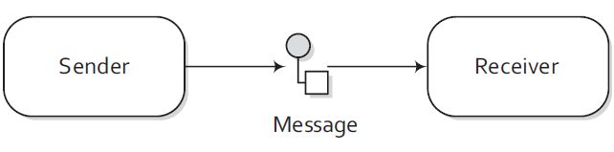
Message Model in Camel …Continued
Message:
Messages are the entities used by systems to communicate with each other when using messaging channels. Messages flow in one direction from a sender to a receiver, as shown in below figure 1.1.
Messages have a body (a payload),
headers, and optional attachments,
as in figure 1.2.
Message
Headers
Attachments
Body

Slide 8
Message Model in Camel …Continued
Exchange:
An exchange in Camel is the message’s container during routing.
An exchange also provides support for the various types of interactions between systems, also known as message exchange patterns (MEPs).
■ InOnly - A one-way message (also known as an Event message). For example, JMS messaging is often one-way messaging.
■ InOut - A request-response message. For example, HTTP-based transports are often
request reply.
//InOnly
getContext().createProducerTemplate().sendBody("direct:startInOnly", "Hello World");
//InOut
Object result = getContext().createProducerTemplate().requestBody("direct:startInOut", "Hello World");

Slide 9
Message Model in Camel …Continued
Additional information part of Exchange:
Camel Exchange consists of the below
components:
■ Exchange ID – A unique ID that
identifies the exchange.
■ MEP – A pattern that denotes
whether you’re using the InOnly or
InOut messaging.
■ Exception – If an error occurs at any time during routing, an Exception will be set in the exception field
■ Properties – Similar to message headers, but they last for the duration of the entire exchange.
Exchange
Exchange ID
MEP
Exception
Properties
In Message
Out Message
Headers
Headers
Attachments
Attachments
Body
Body

Slide 10
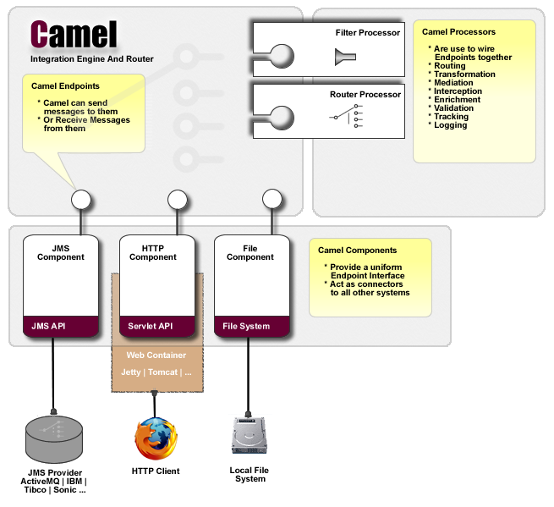
Camel’s Architecture

Slide 11
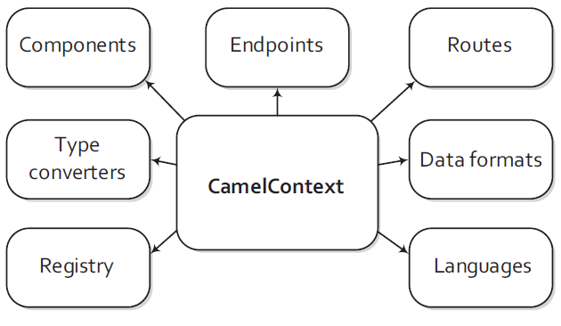
Camel Core concepts
Components | Contains the components used. Camel is capable of loading components on the fly either by auto-discovery on the classpath or when a new bundle is activated in an OSGi container.
Endpoints | Contains the endpoints that have been created.
Type converters | Contains the loaded type converters. Camel has a mechanism that allows you to manually or automatically convert from one type to another.
Routes | Contains the routes that have been added.
Data formats | Contains the loaded data formats.
Registry | Contains a registry that allows us to look up beans. By default, this will be a JNDI registry. When using Camel from Spring, this will be the Spring ApplicationContext. It can also be an OSGi registry if use Camel in an OSGi container.
Languages | Contains the loaded languages. Camel allows us to use many different languages to create expressions.

Slide 12
Camel Core concepts …continued
ROUTING ENGINE
ROUTES
DOMAIN SPECIFIC LANGUAGE
PROCESSOR
COMPONENT
ENDPOINT
PRODUCER
CONSUMER

Slide 13
Camel Core concepts …continued
ROUTING ENGINE
Camel’s routing engine is what actually moves messages under the hood.
This engine isn’t exposed to the developer, but you should be aware that it’s there and that it does all the heavy lifting, ensuring that messages are routed properly.
ROUTES
Routes are obviously a core abstraction for Camel. The simplest way to define a route is as a chain of processors. There are many reasons for using routers in messaging applications. To define a route, a DSL is used.
RouteBuilder builder = new RouteBuilder() {
public void configure() {
errorHandler(deadLetterChannel("mock:error"));
from("direct:a").to("direct:b");
}
};

Slide 14
Camel Core concepts …continued
DOMAIN SPECIFIC LANGUAGE
To wire processors and endpoints together to form routes, Camel defines a DSL.
Consider this example:
Using Java DSL:
from("file:data/inbox")
.filter().xpath("/order[not(@test)]")
.to("jms:queue:order")
Spring DSL, like this:
<route>
<from uri="file:data/inbox"/>
<filter>
<xpath>/order[not(@test)]</xpath>
<to uri="jms:queue:order"/>
</filter>
</route>

Slide 15
Camel Core concepts …continued
PROCESSOR
■ The processor is a core Camel concept that represents a node capable of using, creating, or modifying an incoming exchange.
■ During routing, exchanges flow from one processor to another; as such, you can think of a route as a graph having specialized processors as the nodes, and lines that connect the output of one processor to the input of another.
■ Many of the processors are implementations of EIPs, but one could easily implement their own custom processor and insert it into a route.
Java DSL:
public class MyProcessor implements Processor {
public void process(Exchange exchange) throws Exception {
// do something...
}
}
Invoke inside the route:
from("activemq:myQueue").process("myProcessor");
Spring DSL
<bean id="myProcessor" class="com.acme.MyProcessor"/>

Slide 16
Camel Core concepts …continued
COMPONENT
■ Components are the main extension point in Camel.
■ To date, there are over 80 components in the Camel ecosystem that range in function from data transports, to DSLs, data formats, and so on.
■ From a programming point of view, components are fairly simple: they’re associated with a name that’s used in a URI, and they act as a factory of endpoints.
■ For example, a FileComponent is referred to by file in a URI, and it creates FileEndpoints.
■ Some others are AMQ, HTTP, CXF, FTP, JDBC, KAFKA, DEBEZIUM.

Slide 17
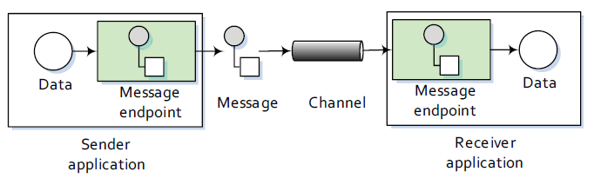
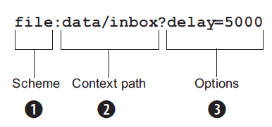
Camel Core concepts …continued
ENDPOINT
An endpoint is the Camel abstraction that models the end of a channel through which a system can send or receive messages. This is illustrated in below Figure 1.3.
In Camel, configuring endpoints using URIs, such as
file:data/inbox?delay=5000
At runtime, Camel will look up an endpoint based on
the URI notation.
Figure 1.4 shows how this works.
The scheme 1 denotes which Camel component handles that type of endpoint. In this case, the scheme of file selects the FileComponent. The FileComponent then works as a factory creating the FileEndpoint based on the remaining parts of the URI.
The context path data/inbox 2 tells the FileComponent that the starting folder is data/inbox.
The options, delay=5000 3 indicates that files should be polled at a 5 second interval.

Slide 18
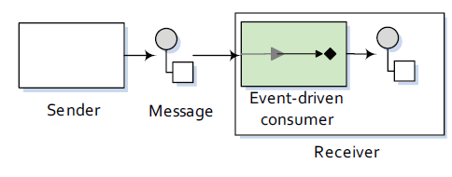
Camel Core concepts …continued
EVENT-DRIVEN CONSUMER
The most familiar consumer is probably the event-driven consumer, which is illustrated in Figure 1.6.
■ This kind of consumer is mostly associated with client-server architectures and web services.
■ It’s also referred to as an asynchronous receiver in the EIP world.
■ An event-driven consumer listens on a particular messaging channel, usually a TCP/IP port or a JMS queue, and waits for a client to send messages to it.
■ When a message arrives, the consumer wakes up and takes the message for processing.

Slide 19
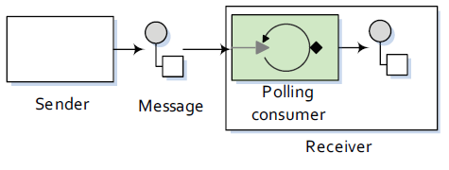
Camel Core concepts …continued
POLLING CONSUMER
The other kind of consumer is the polling consumer illustrated in Figure 1.7.
■ In contrast to the event-driven consumer, the polling consumer actively goes and fetches messages from a particular source, such as an FTP server.
■ The polling consumer is also known as a synchronous receiver in EIP lingo, because it won’t poll for more messages until it has finished processing the current message.
■ A common flavor of the polling consumer is the scheduled polling consumer, which polls at scheduled intervals. File, FTP, and email transports all use scheduled polling consumers.

Slide 20
A COMPLETE SAMPLE CODE SNIPPET IN JAVA DSL:
import org.apache.camel.CamelContext;
import org.apache.camel.builder.RouteBuilder;
import org.apache.camel.impl.DefaultCamelContext;
public class FileCopierWithCamel {
public static void main(String args[]) throws Exception {
CamelContext context = new DefaultCamelContext();
context.addRoutes(new RouteBuilder() {
public void configure() {
from("file:data/inbox?noop=true")
.to("file:data/outbox");
}
});
context.start();
Thread.sleep(10000);
context.stop();
}
}

Slide 21
Thank You

Slide 22
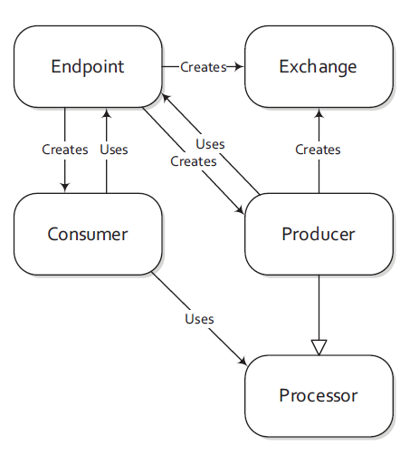
Camel Core concepts …continued
PRODUCER
A producer is the Camel abstraction that refers to an entity capable of creating and sending a message to an endpoint.
CONSUMER
A consumer is the service that receives messages produced by a producer, wraps them in an exchange, and sends them to be processed. Consumers are the source of the exchanges being routed in Camel.
Figure 1.5 illustrates where the producer and Consumer fits in with other Camel concepts.

